Slide 1
API Security for DevOps and InfoSec
Subra Kumaraswamy
@subrak
Tim Mather
@mather_tim
Apigee
@apigee

Slide 2

youtube.com/apigee

Slide 3

slideshare.net/apigee

Slide 4


@Subrak
Subra Kumaraswamy
@mather_tim
Tim Mather

Slide 5
Agenda
The API security architecture framework
DevOps in the context of API security
InfoSec in the context of API security
API threat protection
Security analytics: what to expect

Slide 6
API Security Goals
End-to-end security managed through configuration
Security (prevention & detection) integrated into the architecture to limit attack surface
Flexibility to integrate with external security services
API and app-centric security for threat protection
Notes:
End-to-end security enabled by configuration
E.g. TLS, OAuth, Role-based access control, rate limiting
Security (prevention & detection) integrated into the product to limit attack surface
E.g. Access control, separation of duties (RBAC), logging, auditing,
Flexibility to integrate with external security services
Developers have choice to enforce ‘appropriate security’ based on API sensitivity and use case (e.g., protect API abuse with quota enforcement)
Use external token store option where our OAuth verification can use external token store
App-centric security for app protection
Developers can configure security via API for automation and agility
Developers can extend the authentication and authorization model to users using built-in identity services (e.g., OpenLDAP integration)
Do all of the above regardless of deployment – cloud or on-premise

Slide 7
Architecture

Slide 8
Security has to be approached from the API consumption and exposure perspectives

Slide 9
Security Architecture: Consumption vs. Exposure
Consumption
Internet
Trust
Boundary
Exposure
Notes:
API tier allows decoupling of security models and creates loose coupling between applications consuming API and backend services
Consumption tier demands support for agile security functions for app developers as well as flexible security mechanism for various API consumer types. For e.g. Your mobile app accessing your employee data will have different security requirements from your application that is developed by a 3rd party developed apps available and distributed via android marketplace or Apple store.
Exposure tier on the other hand focus consistently enforcing security irrespective of what apps are connecting to the backend.
Exposure tier needs to be concerned about fine granular authorization to the API functions by the apps

Slide 10









Security Architecture
Identity & Management
Keys/token management
Certificate management
Policy management
RBAC management
User management
Developers
InfoSec / API architect / DevOps
API security
Authentication
Authorization
Policy enforcement
Traffic management
Logging & auditing
Apps
Key store
Policy store
Log store
Threat Protection
TLS
DDoS
Rate limiting & quota
Payload protection
Analytics
Compliance (SOC 2, PCI DSS, HIPAA) and cloud security

Slide 11
So how does this manifest from an API security capability standpoint?

Slide 12
API management solutions must address the security considerations of various stakeholders and consumers of API
Stakeholders | API Exposure Security | API Consumption Security
DevOps | ☑ | ☑
App Developers |  | ☑
InfoSec | ☑ | ☑
API architects | ☑
Business owner | ☑ | ☑
End users |  | ☑

Slide 13
DevOps and Security

Slide 14
The developer (DevOps) needs to create and deploy apps and configure security (not code) API Security considerations:
Authentication of developers, apps, and end users – API Key protection, Token management
Fine-grained authorization for apps using API keys, OAuth, and SAML authentication
Sensitive data in XML / JSON payload protected with encryption
Self-service capabilities for DevOps function - testing security prior to deployment, promoting code and verifying security configuration

Slide 15



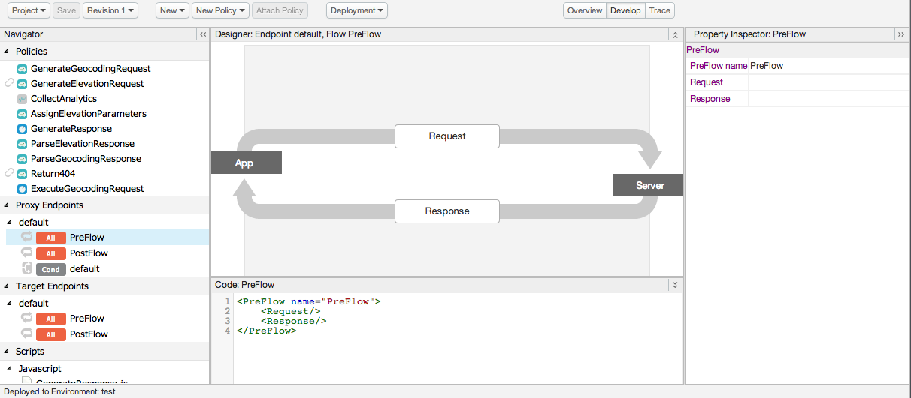
API Service Runtime View
Rate limit
OAuth
JS/Java callout
Threat protection
Native
Node.js container
Fault handling
XSL
Service callout
Cache
HTTP(S)
Load-balancing
Fail-over
HTTP(S)
Apps
Back-end service
Management portal

Slide 16
DevOps must be able to choose the authentication and authorization schemes to support app security needs

Slide 17
Authentication & Authorization
Use Case | Authentication | Authorization
B2B | Two-way TLS, API key | OAuth v1 and OAuth v2 policies Client credentials grant (two-legged OAuth)
Trusted Apps | API key (client credentials), Basic Authentication, IP address | OAuth v1 and OAuth v2 policies Resource owner password grant Implicit grant with limited permissions
Untrusted Apps | Two-way TLS, OAuth token with Scope OpenID Connect SAML 2.0 Bearer assertion | OAuth v1 and OAuth v2 policies Authorization code grant (three-legged OAuth)
Identity tracking | Identity-based access tracking policy Verify API key
Notes:
Apigee’s API Services addresses your security scenarios surrounding identity tracking, authentication and authorization
A lot of you are probably already familiar with OAuth, which is the most widely accepted way of authenticating and authorizing users and data.
OAuth defines a concept of a “grant type”, which represents the resource owner’s authorization to use a specific type of resource. Grant flows generate an access token which is used to represent that authorization for API requests.
B2B – validate using application identifier (API key and shared secret)
Trusted developer app – validate using a combination of application identifier (verify that it’s a trusted app) and user credentials.
Untrusted developer app – no access to credentials. Requires some sort of server to validate user credentials and obtain user’s consent for app to access data. Customers can provide this authentication server, or Apigee can act in that role.
HTML5 – because app is inherently insecure, implicit grant doesn’t generally require app credentials at all, just user credentials.
Apigee supports all of these OAuth grant types through built-in policies for both OAuth v1.0a and OAuth v2.0. OAuth 1.0 policy is an older version that uses signatures to authenticate a request, and OAuth 2.0 is the more recent version.
Apigee also supports authentication and authorization using SAML 2.0
More details:
OAuth 2.0
Single policy, configurable to perform each of the different grant types.
Highly configurable, so data to perform the grant can be taken from headers, path variables, query prams or payload.
SAML 2.0
The Security Assertion Markup Language (SAML) specification defines formats and protocols that enable applications to exchange XML-formatted information for authentication and authorization. A "security assertion" is a trusted token that describes an attribute of an app, an app user, or some other participant in a transaction. Security assertions are managed and consumed by two types of entities:
Identity providers: Generate security assertions on behalf of participants
Service providers: Validate security assertions through trusted relationships with identity providers
Apigee Edge can act as an identity provider and as a service provider. It acts as an identity provider by generating assertions and attaching them to request messages, making those assertions available for processing by backend services. It acts as a service provider by validating assertions on inbound request messages. Two new policies available via the user interface allow you to generate and validate SAML assertions:
The GenerateSAMLAssertion policy
The ValidateSAMLAssertion policy
Identity Tracking
While not strictly an authentication mechanism, identity tracking using API keys allows you to track who’s using your API and to enforce certain restrictions, such as rate limits.
Identity tracking is most appropriate when there’s no user data involved and there are no other restrictions on the data. Suitable for apps such as HTML5 widgets which developers would like to get widely adopted.

Slide 18
InfoSec

Slide 19
The API architect must be able to securely expose the back-end services with necessary authentication, authorization, message security, and traffic management.
Security considerations:
Authentication of API services: LDAP, active directory, SAML, OAuth, two-way TLS
Fine-grained authorization of APIs
Quota management
Message security

Slide 20
The information security administrator needs to manage security of data-at-rest and data-in-transit for both API consumption and exposure layers.
Security considerations:
Configurable security policies to meet organizational standards
Transport-layer protection using TLS
Protect sensitive data stored and processed in the API gateway and mobile devices
User and role management
Threat management (DoS, spikes, injection attacks)
Logging and auditing

Slide 21
Information security must be able to manage users (developers, API architect, business users) and privileges (roles) to in turn manage multiple levels of trusted users.

Slide 22
User and Role Management
Scenario | Identity services
User provisioning | Configure fine-grained control of user access to data features and functionality; flexible provisioning and management of users
RBAC management | Employ RBAC at every layer to protect sensitive information, including API keys, TLS certificates, OAuth tokens, and audit logs
Manage groups | Group users based on any number of criteria, including location and interests, to create fine-grained authorization
Identity provider | In general, an API platform must be able to integrate with any identity provider that: has an API supports SAML supports LDAP v3 (for on-premise only)

Slide 23
Information security must be able to meet governance requirements and manage compliance when handling PCI DSS or HIPAA use cases

Slide 24
Infrastructure & Compliance
Scenario | Infrastructure Security & Compliance
European Data Protection Directive | Safe Harbor program Registered with U.S. government; Apigee meets the requirements of the European Union Data Directive
SOC 2 | Apigee has completed a SOC 2 Type 1, and will be completing a SOC 2 Type 2 in 2014
PCI-DSS, HIPAA | PCI DSS certified and HIPAA compliance API in-cloud offering must be PCI DSS Level One certified to protect credit card information API gateway in-cloud must meet a third-party attestation to HIPAA “compliance” to protect personal data and security requirements
API health visibility | Round-the-clock monitoring Real-time and historic API health visibility API security and compliance tracking Component and process monitoring

Slide 25
Threat Protection

Slide 26
Types of API Threats
Spoofing of identity
Network eavesdropping
Man-in-the-middle attacks
Velocity attack using legitimate API calls
Elevation of privileges by applications and developers
Data tampering and injection attacks that lead to information disclosure
Disclosure of confidential data stored and processed in mobile, API, and back-end services
Theft of credentials: API keys, tokens, or encryption keys

Slide 27
Threat Protection
Scenario | Threat Protection
Denial-of-service (DoS) attack (both inadvertent and deliberate) | Spike arrest Protection against instantaneous bursts of traffic Access control Imposing limits on who can access your API
Injection and scripting attacks | Configurable protection Allows payload scanning for SQL, JavaScript, etc.
XML/JSON threats | XML and JSON threat protection Keep malformed payloads out of your system
Notes:
In addition to identity management, authentication and authorization you also need to be concerned about threat protection. Apigee’s API Services has you covered for the threats you may face.
Spike arrest – common concept - protects you against instantaneous bursts in traffic. Here’s something to give you a sense of why this is needed even in non-attack scenarios: One of our customers once had an application that checked the weather at the top and bottom of the hour, which doesn’t sound all that bad until you consider that there were hundreds of thousands of copies of this app in the field…so that simple weather check turned into a twice-hourly denial-of-service attack. The attack caused their back-end systems a pretty large amount of trouble until they implemented spike arrest to allow them to manage these huge influxes of inadvertent traffic.
Injection and scripting attacks – common concept - can cause security breaches and all sorts of other mayhem. I think we’ve probably all heard the story of the school student whose name was “DROP TABLE STUDENTS” and how that caused a school to delete its student database, but it’s also possible for APIs to post scripts that makes their way into Web forms and open up the possibility of compromised user security.
XML and JSON attacks may not be quite as obvious, but they can be just as damaging. XML and JSON documents can be nested to ten thousand levels, or contain element, attribute or object names that are megabytes in length, and so on.
Apigee provides a spike arrest policy that allows for per-minute and per-second traffic burst handling.
The configurable XML and JSON attack policies to tell Apigee what’s allowable and what’s not, so that a payload that doesn’t match your parameters can be rejected.
Regular expression protection allows you to inspect any part of an inbound request for the marks of a number of different types of attacks, such as SQL or JavaScript injection attacks
In some cases it’s appropriate to restrict specific APIs to only certain IP addresses at the API level – when certain requests are internal-only, for example. And of course, you can use Apigee’s scripting capabilities to restrict APIs based on just about any other criteria you can name.

Slide 28
Example: JSON
Error Code Message
ExceededContainerDepth JSONThreatProtection[{0}]:Exceeded container depth at line {1}
ExceededObjectEntryCount JSONThreatProtection[{0}]: Exceeded object entry count at line {1}
ExceededArrayElementCount JSONThreatProtection[{0}]: Exceeded array element count at line {1}
ExceededObjectEntryNameLength JSONThreatProtection[{0}]: Exceeded object entry name length at line {1}
ExceededStringValueLength JSONThreatProtection[{0}]: Exceeded string value length at line {1}
SourceUnavailable JSONThreatProtection[{0}]:: Source {1} is not available
NonMessageVariable JSONThreatProtection[{0}]: Variable {1} does not resolve to a Message
ExecutionFailed JSONThreatProtection[{0}]: Execution failed. reason: {1}

Slide 29
Security Analytics

Slide 30
Security Analytics
Start with operational events such as runtime events
Correlate against volume information such as quotas and spikes
Correlate with threat protection information, such as attempted poisoning and injection attacks
Correlate against security sensor data; effectively using your API management platform as a security sensor unto itself

Slide 31



Top considerations and takeaways
End-2-end security architecture includes consumption and exposure of APIs
DevOps (need for speed, flexibility) and InfoSec (need for consistent protection) go hand in hand
Agility, speed, and scale with security through configuration, not coding
App-to-API Security
App-to-Backend Security
User
App
Developer
API
API Team
Backend

Slide 32
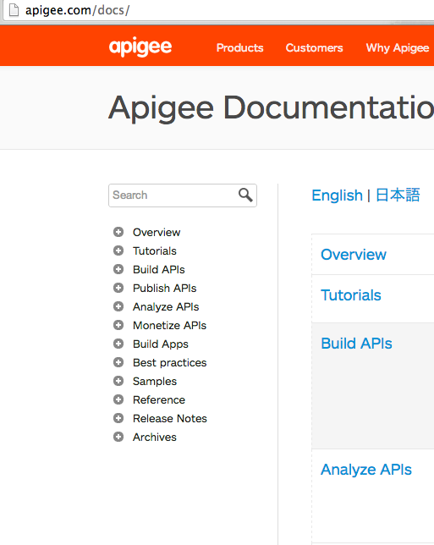
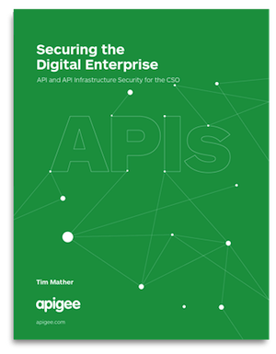
Download eBook:
http://bit.ly/1hxcavY
See Apigee docs:
http://apigee.com/docs
Notes:
Presenter: Tim
1) consumption versus exposure
2) devops (speed, flexibility) and InfoSec (consistent protection)
3) configuration (policies) not coding
Greater depth:
DevOps in the context of API security
InfoSec in the context of API security
API threat protection
Security analytics: what to expect

Slide 33
Questions?
@Subrak
Subra Kumaraswamy
@mather_tim
Tim Mather

Slide 34
Thank You
Apigee
@apigee

